Slide 1
CS312 Artificial Intelligence
Lecture # 05
HITEC University, Taxila
Mr. Mubashir Iqbal
Fall-2025

Slide 2
Lecture Content
Informed Search Algorithms - I:
Heuristic Function and its role
Best First Search (BFS)
Beam Search - Optimized Best First Search
A Star(A*) Search Algorithm
AO Star (AO-) Search Algorithm

Slide 3
Informed Search
Informed Search, also called Heuristic Search, is a type of search strategy in Artificial Intelligence that uses extra knowledge about the problem (called a heuristic) to guide the search process toward the goal more efficiently than uninformed methods.
Informed search algorithms do not explore blindly; instead, they estimate how close a state is to the goal, allowing the agent to choose the most promising path first.
Key Explanation
It uses heuristic functions (h(n)) that provide an approximate cost or distance to the goal.
It is generally faster and more efficient than uninformed search.
It reduces unnecessary exploration of irrelevant states.

Slide 4
Key characteristics
1. Heuristic Function (h(n)): This function provides an estimate of the cost from a given node ‘n’ to the goal node. It is a “rule of thumb” or an educated guess, not necessarily a perfectly accurate measure.
2. Efficiency: Heuristic search aims to reduce computational complexity and speed up decision-making by prioritizing the most promising paths and avoiding the exploration of less likely or suboptimal paths.

Slide 5
Key characteristics
3. Informed Search: Unlike uninformed search algorithms (like Breadth-First Search or Depth-First Search) that explore the search space systematically without specific knowledge, heuristic search incorporates domain-specific knowledge to guide the search.
4. Optimality vs. Near-Optimality: While some heuristic algorithms (like A*) can guarantee finding the optimal solution under certain conditions (admissibility and consistency of the heuristic), others may find a good, near-optimal solution rather than the absolute best, especially in complex problems with large search spaces.

Slide 6
Applications:
Heuristic search algorithms are widely used in various AI applications, including:
Pathfinding and Navigation: Finding the shortest or most efficient path in robotics and game AI.
Game Playing: Developing AI agents that can make strategic decisions in games like chess or Go.
Planning and Scheduling: Solving complex planning problems in logistics and resource management.
Puzzle Solving: Solving classic AI puzzles like the 8-puzzle or Rubik’s Cube.

Slide 7
Heuristic Function and its role

Slide 8
Heuristic Function and its role
Heuristic search algorithms in AI are problem-solving methods that use intelligent strategies to find solutions more efficiently than exhaustive or “blind” search methods. They employ a heuristic function to estimate the cost or distance from a current state to the goal state, guiding the search towards more promising paths.
“Heuristic” means to discover or to find by trial and error.
A heuristic is a rule-of-thumb or educated guess that helps guide search algorithms.
Heuristic search uses domain-specific knowledge to find solutions faster than uninformed search.

Slide 9
Best First Search (BFS)

Slide 10
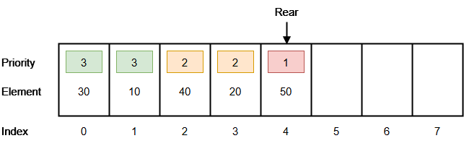
Best First Search (BFS)
Best-First Search is a heuristic-based search algorithm that explores a graph by expanding the most promising node chosen according to a specified rule or evaluation function.
It combines the advantages of Breadth-First and Depth-First Search by using heuristic information (h(n)) to guide the search process.
Best-First uses a priority queue (frontier) ordered by a heuristic score f(n) and always expands the node with smallest score.

Slide 11
Best First Search (BFS)
Working Principle:
Start from the initial node.
Use an evaluation function f(n) = h(n) to estimate how close the node is to the goal.
Expand the node with the lowest heuristic cost (most promising).
Continue until the goal node is found or all nodes are explored.
Key Terms:
h(n): Heuristic function that estimates the cost from node n to the goal.
Open List: Nodes yet to be explored.
Closed List: Already explored nodes.
Evaluation Function: Used to decide which node to explore next.

Slide 12
Best First Search (BFS)
Advantages:
More efficient than Blind Search (like BFS/DFS).
Uses domain knowledge (heuristics) to reduce exploration.
Works well for pathfinding and AI game agents.
Limitations:
May get stuck in local minima (chooses nodes that seem best locally but not globally).
Performance depends heavily on the quality of heuristic used.
May not always find the optimal path.

Slide 13
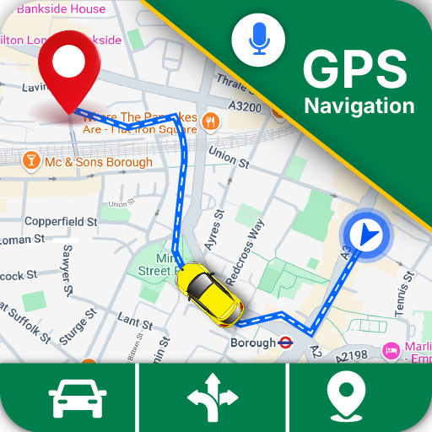
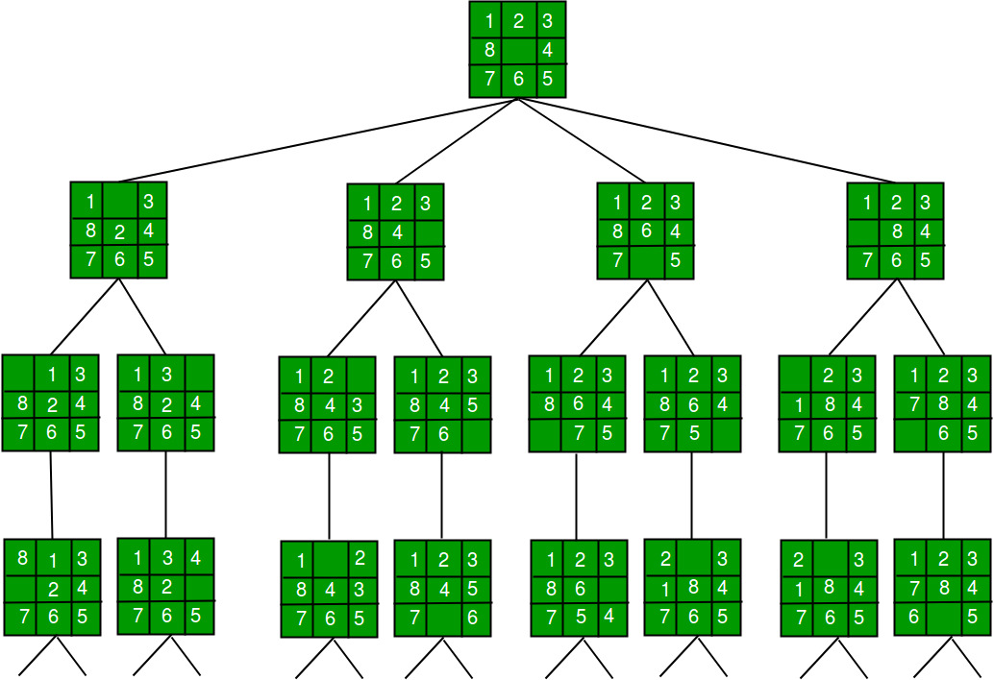
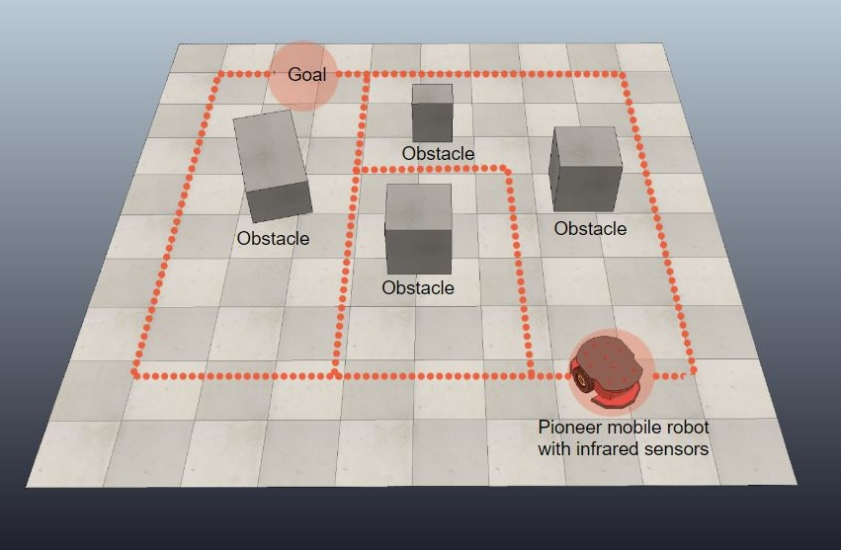
Best First Search (BFS)
Applications:
Route finding (GPS navigation)
Robot path planning
Puzzle solving (e.g., 8-puzzle problem)
Game AI (decision making)

Slide 14
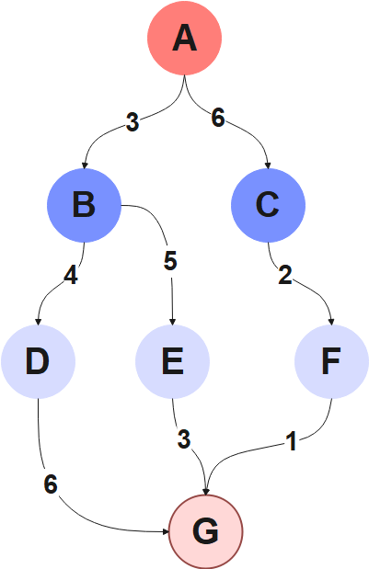
BFS – Example 0
Heuristic Knowledge
Node | h(n)
A→ G | 10
B→ G | 8
C→ G | 5
D→ G | 7
E→ G | 3
F→ G | 6
G→ G | 0
Solution
Step | Open List (sorted by h(n)) | Close List (Path So Far)
1 | [A(10)] | A
2 | [C(5), B(8)] | A → C
3 | [F(6), B(8)] | A → C → F
4 | [G(0), B(8)] | A → C → F → G
Path: A → C → F → G

Slide 15
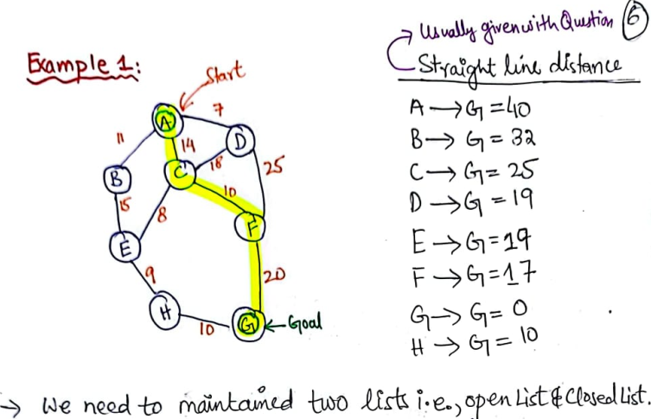
BFS – Example 1
35

Slide 16
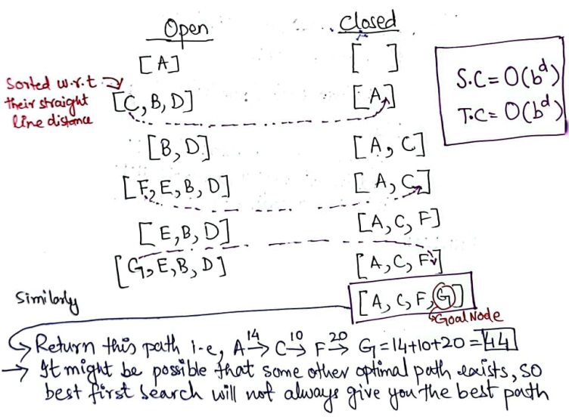
BFS – Example 1

Slide 17
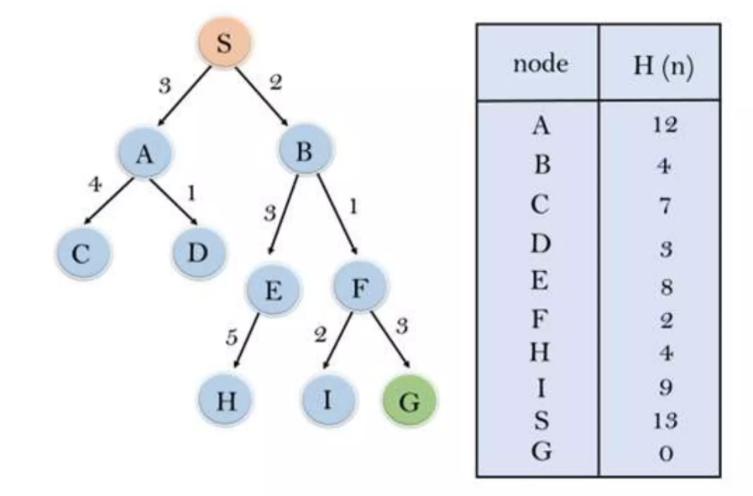
BFS – Example 2

Slide 18
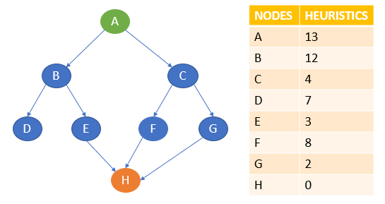
BFS – Example 3

Slide 19
Beam Search - Optimized Best First Search

Slide 20
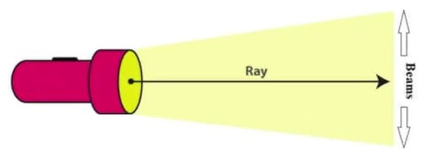
Beam Search - Optimized Best First Search
Beam Search is an optimized version of Best-First Search that limits the number of nodes stored in memory.
It explores only the “best” few nodes at each level, instead of all possible nodes. Designed to reduce memory and computation requirements while maintaining good search quality.
How It Works
Start from the initial node.
Generate all possible successors (children).
Rank them based on heuristic value (like in Best-First Search).
Select only the top ‘k’ nodes (where k = beam width).
Expand those nodes in the next iteration.
Repeat until goal is reached or no better nodes are found.

Slide 21
Beam Search - Optimized Best First Search
Beam Width (k): A fixed number defining how many nodes to keep at each level.
Smaller k → faster but may miss optimal path.
Larger k → better accuracy but more memory use.
Advantages
Faster than Best-First Search.
Uses less memory.
Good for large state spaces (e.g., language models, robotics, translation).
Disadvantages
May miss the optimal path due to limited exploration.
Performance depends heavily on beam width (k).
Not complete or optimal for all problems.

Slide 22
Applications of Beam Search
1. Machine Translation (NLP): Used in models like Google Translate — Beam Search helps select the most likely sentence translation by keeping only the top k best partial translations at each step.
2. Speech Recognition: Systems like Google Assistant or Apple Siri use Beam Search to choose the most probable word sequences from possible interpretations of speech input.
3. Text Generation (Chatbots / LLMs): In GPT models, Beam Search improves the quality of generated sentences by exploring multiple possible continuations and selecting the most coherent ones.
4. Path Planning in Robotics: Beam Search helps robots decide navigation paths efficiently by exploring only the best few movement options instead of all possible routes.
5. Game Playing AI: Games like Chess or Go use Beam Search to reduce the massive search space while still considering promising moves at each step.
6. Autocomplete / Text Prediction: Used in keyboards (like Gboard or SwiftKey) to predict the next word based on the most likely combinations of current input.
7. Optimization in Scheduling / Planning Problems: Beam Search finds near-optimal solutions when the search space is too large for exhaustive methods — e.g., airline crew scheduling, delivery route planning.

Slide 23
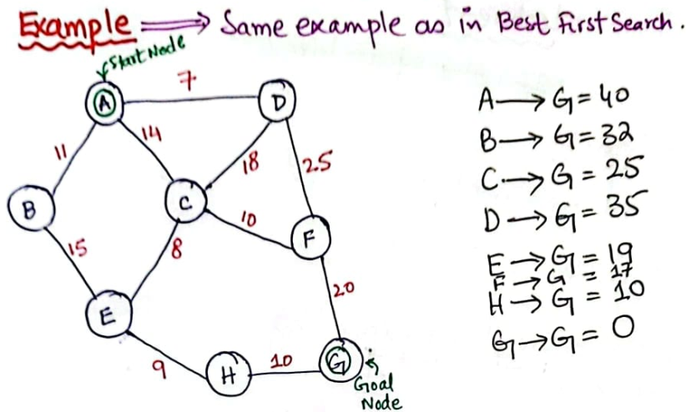
Beam Search – Example 0

Slide 24
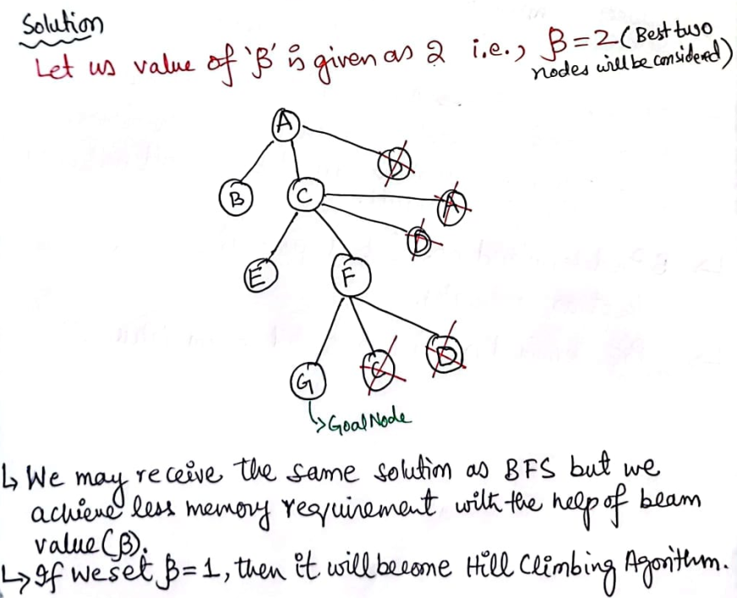
Beam Search – Example 0

Slide 25
A Star(A*) Search Algorithm

Slide 26
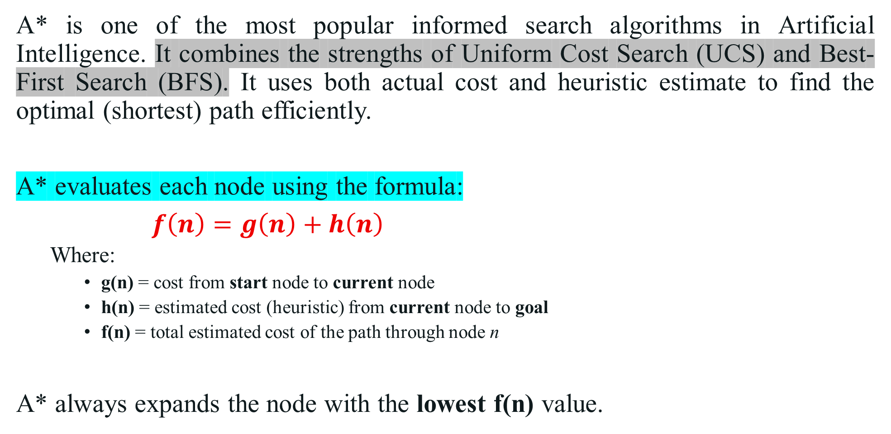
A Star(A*) Search Algorithm
A* is one of the most popular informed search algorithms in Artificial Intelligence. It combines the strengths of Uniform Cost Search (UCS) and Best-First Search (BFS). It uses both actual cost and heuristic estimate to find the optimal (shortest) path efficiently.
A* evaluates each node using the formula:
$f\left(n\right)=g\left(n\right)+h\left(n\right)$
Where:
g(n) = cost from start node to current node
h(n) = estimated cost (heuristic) from current node to goal
f(n) = total estimated cost of the path through node n
A* always expands the node with the lowest f(n) value.

Slide 27
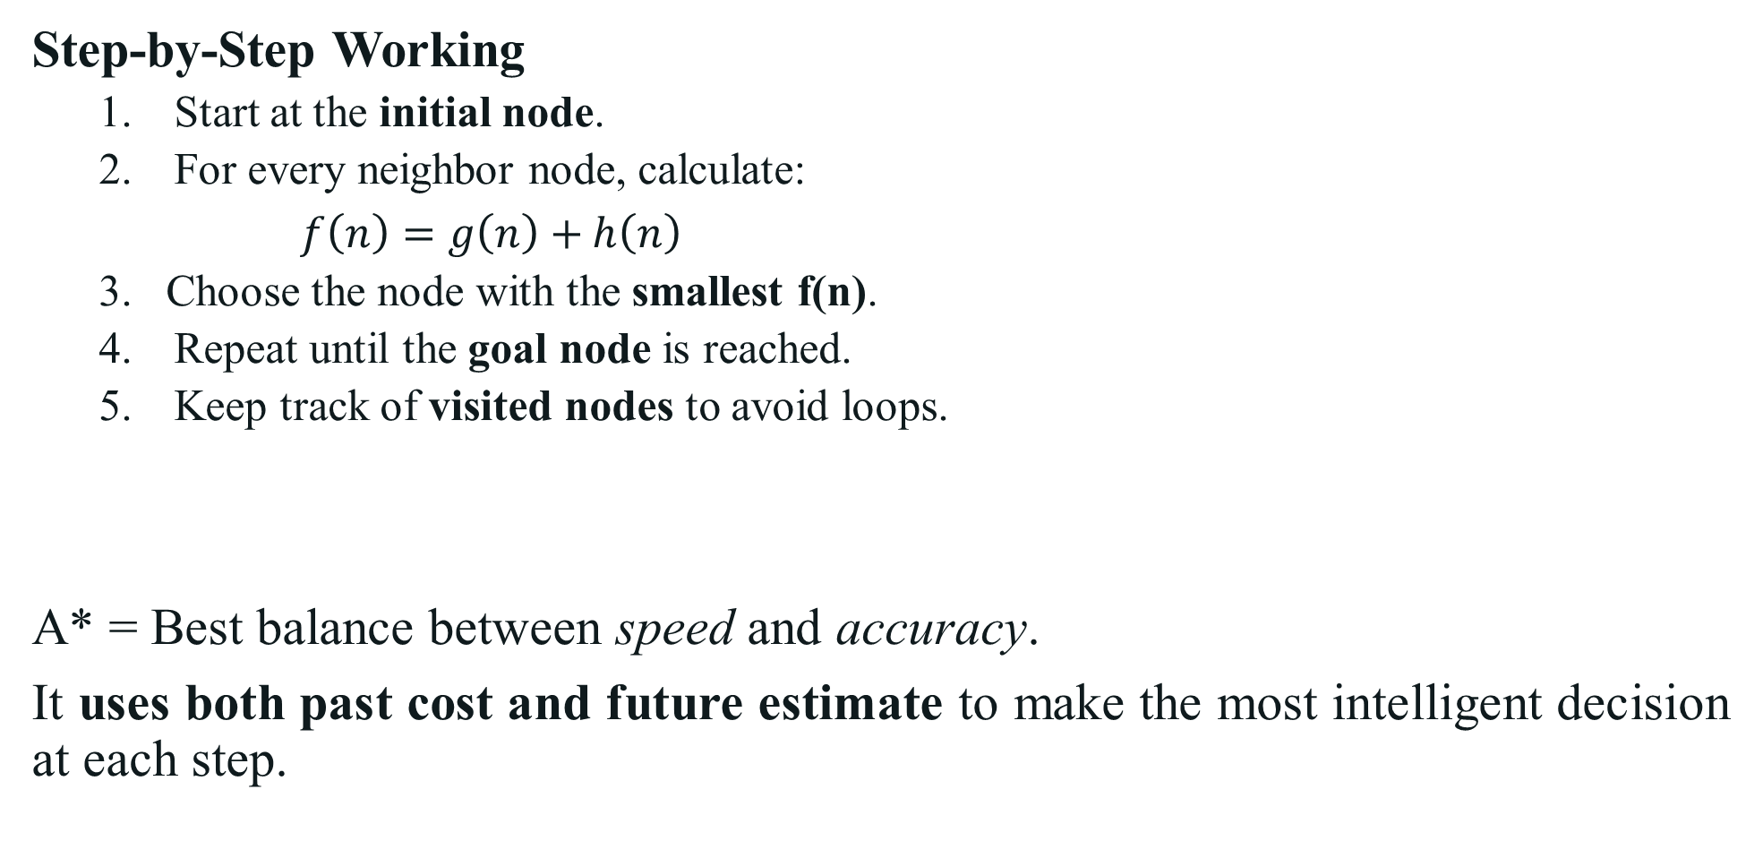
A Star(A*) Search Algorithm
Step-by-Step Working
Start at the initial node.
For every neighbor node, calculate:
$f\left(n\right)=g\left(n\right)+h\left(n\right)$
Choose the node with the smallest f(n).
Repeat until the goal node is reached.
Keep track of visited nodes to avoid loops.
A* = Best balance between speed and accuracy.
It uses both past cost and future estimate to make the most intelligent decision at each step.

Slide 28
A Star(A*) Search Algorithm
Advantages
Optimal (finds shortest path if h(n) is admissible).
Complete (will find a solution if one exists).
Uses both cost and heuristic, making it efficient.
Disadvantages
Can be slow for large search spaces.
Memory intensive, as it stores many nodes.
Heuristic function quality directly affects performance.
Real-World Applications
Navigation systems (Google Maps, GPS routing).
Robot path planning and motion control.
Game AI (pathfinding for characters).
Network routing and scheduling problems.

Slide 29
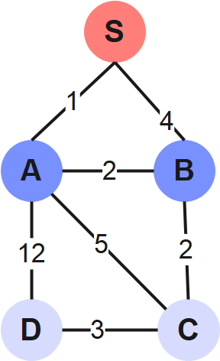
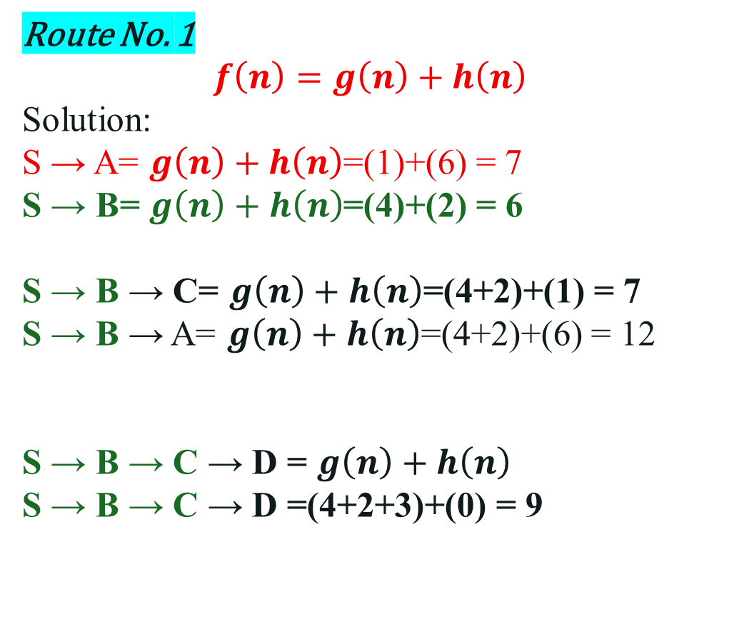
A Star(A*) – Example 0
Heuristic Knowledge
Node | h(n)
S→ D | 7
A → D | 6
B → D | 2
C → D | 1
D → D | 0
Route No. 1
$$f\left(n\right)=g\left(n\right)+h\left(n\right)$$
Solution:
S → A= $g\left(n\right)+h\left(n\right)$=(1)+(6) = 7
S → B= $g\left(n\right)+h\left(n\right)$=(4)+(2) = 6
S → B → C= $g\left(n\right)+h\left(n\right)$=(4+2)+(1) = 7
S → B → A= $g\left(n\right)+h\left(n\right)$=(4+2)+(6) = 12
S → B → C → D = $g\left(n\right)+h\left(n\right)$
S → B → C → D =(4+2+3)+(0) = 9

Slide 30
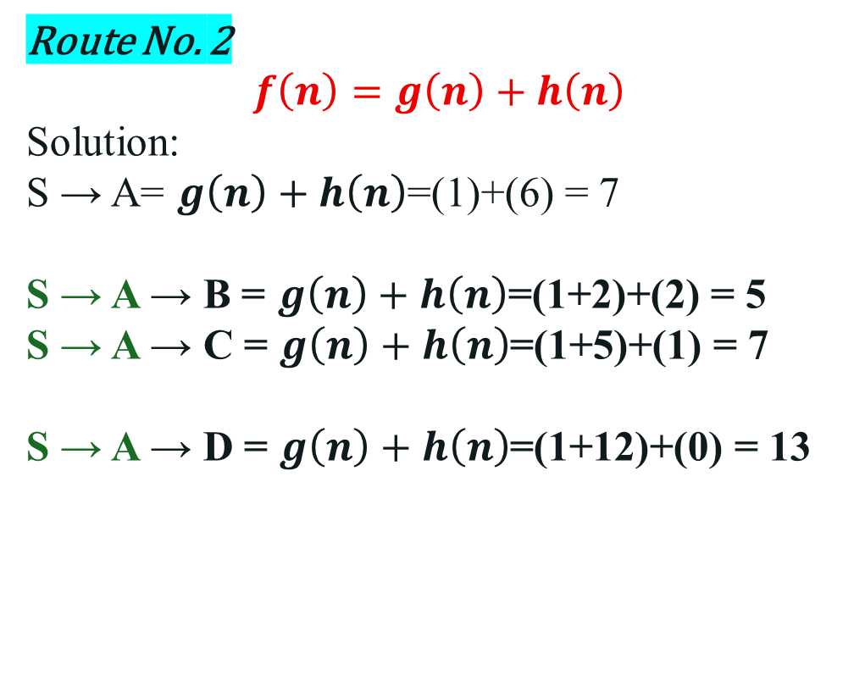
A Star(A*) – Example 0
Heuristic Knowledge
Node | h(n)
S→ D | 7
A → D | 6
B → D | 2
C → D | 1
D → D | 0
Route No. 2
$$f\left(n\right)=g\left(n\right)+h\left(n\right)$$
Solution:
S → A= $g\left(n\right)+h\left(n\right)$=(1)+(6) = 7
S → A → B = $g\left(n\right)+h\left(n\right)$=(1+2)+(2) = 5
S → A → C = $g\left(n\right)+h\left(n\right)$=(1+5)+(1) = 7
S → A → D = $g\left(n\right)+h\left(n\right)$=(1+12)+(0) = 13

Slide 31
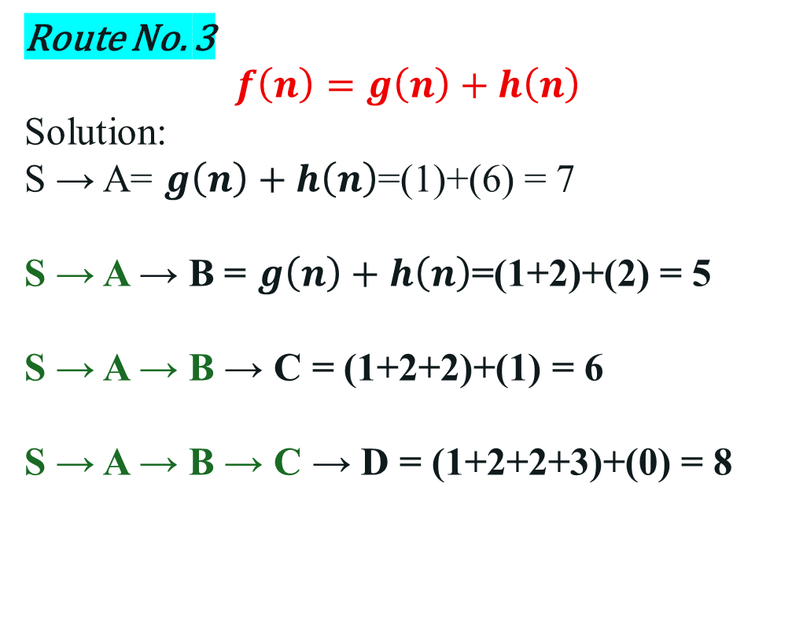
A Star(A*) – Example 0
Heuristic Knowledge
Node | h(n)
S→ D | 7
A → D | 6
B → D | 2
C → D | 1
D → D | 0
Route No. 3
$$f\left(n\right)=g\left(n\right)+h\left(n\right)$$
Solution:
S → A= $g\left(n\right)+h\left(n\right)$=(1)+(6) = 7
S → A → B = $g\left(n\right)+h\left(n\right)$=(1+2)+(2) = 5
S → A → B → C = (1+2+2)+(1) = 6
S → A → B → C → D = (1+2+2+3)+(0) = 8

Slide 32
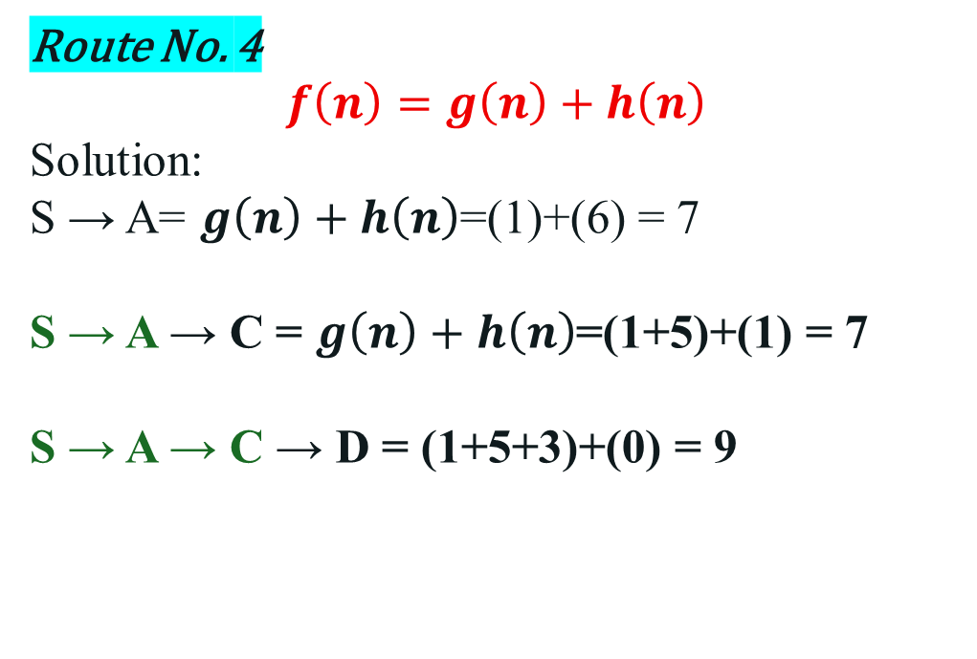
A Star(A*) – Example 0
Heuristic Knowledge
Node | h(n)
S→ D | 7
A → D | 6
B → D | 2
C → D | 1
D → D | 0
Route No. 4
$$f\left(n\right)=g\left(n\right)+h\left(n\right)$$
Solution:
S → A= $g\left(n\right)+h\left(n\right)$=(1)+(6) = 7
S → A → C = $g\left(n\right)+h\left(n\right)$=(1+5)+(1) = 7
S → A → C → D = (1+5+3)+(0) = 9

Slide 33
A Star(A*) – Example 0
Heuristic Knowledge
Node | h(n)
S→ D | 7
A → D | 6
B → D | 2
C → D | 1
D → D | 0
Final result:
Route No. 1 = 9
Route No. 2 = 13
Route No. 3 = 8
Route No. 4 = 9
Algorithm select the route with minimum estimation Cost : Route 03
S → A → B → C → D = (1+2+2+3)+(0) = 8

Slide 34
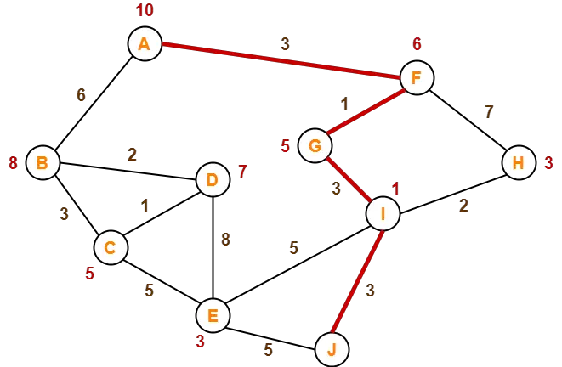
A Star(A*) – Example 1
Solve this
Heuristic Knowledge
Node | h(n)
A → J | 10
B → J | 8
C → J | 5
D → J | 7
E → J | 3
F → J | 6
G → J | 5
H → J | 3
I → J | 1
J → J | 0

Slide 35
AO Star (AO*) Search Algorithm

Slide 36
AO Star (AO*) Search Algorithm
AO* stands for And-Or Star Search.
It is used to find optimal solutions in AND-OR graphs, where problems can be divided into subproblems (AND nodes) and alternative solutions (OR nodes). Unlike A*, which deals with linear paths, AO* handles problem decomposition and interdependent solutions.
Why AO*?
Some problems can’t be represented as a simple path, they look more like a decision tree.
Some nodes require all sub-tasks to succeed (AND).
Some nodes require any one of multiple options (OR).
AO* is designed to search and choose the best combination of tasks that leads to the goal efficiently.

Slide 37
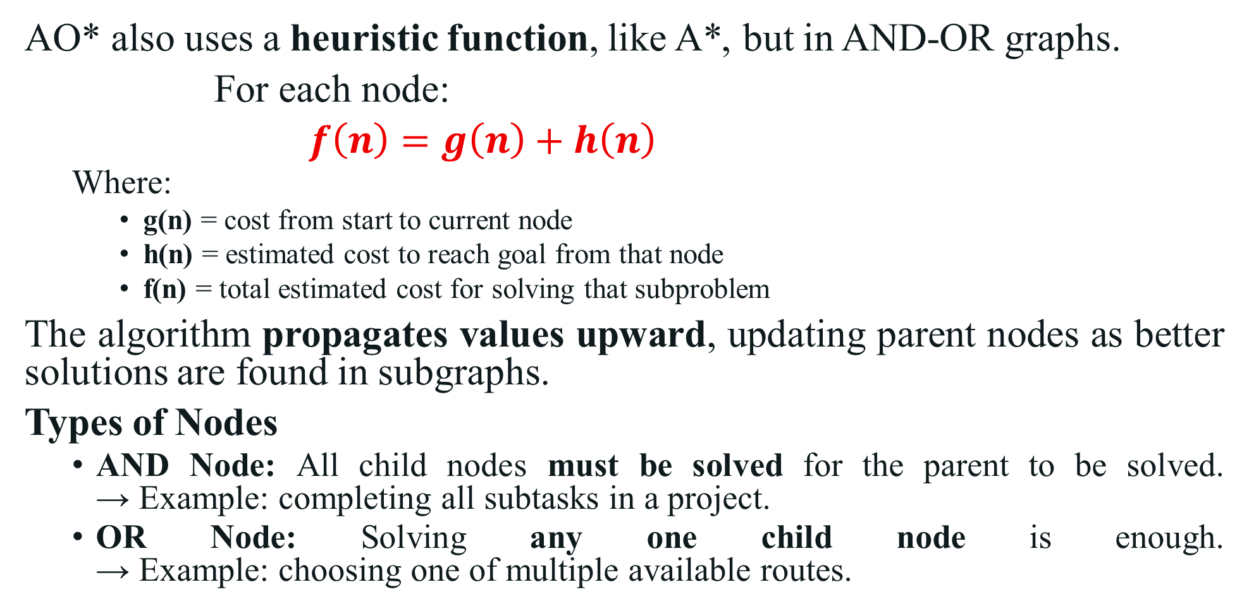
AO Star (AO*) Search Algorithm
AO* also uses a heuristic function, like A*, but in AND-OR graphs.
For each node:
$f\left(n\right)=g\left(n\right)+h\left(n\right)$
Where:
g(n) = cost from start to current node
h(n) = estimated cost to reach goal from that node
f(n) = total estimated cost for solving that subproblem
The algorithm propagates values upward, updating parent nodes as better solutions are found in subgraphs.
Types of Nodes
AND Node: All child nodes must be solved for the parent to be solved. → Example: completing all subtasks in a project.
OR Node: Solving any one child node is enough. → Example: choosing one of multiple available routes.

Slide 38
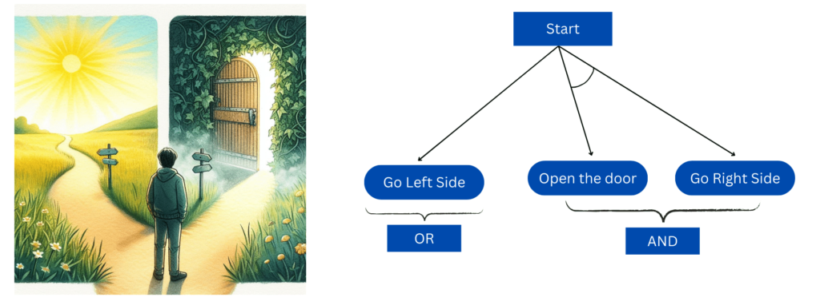
AO Star (AO*) Search Algorithm
Types of Nodes
AND Node: All child nodes must be solved for the parent to be solved. → Example: completing all subtasks in a project.
OR Node: Solving any one child node is enough. → Example: choosing one of multiple available routes.

Slide 39
AO Star (AO*) Search Algorithm
Step-by-Step Working
Start from the root node.
Expand the most promising node using heuristic estimates.
Calculate f(n) for each child node.
If the node is AND-type, combine the cost of all children. If it’s OR-type, select the minimum cost child.
Propagate updated costs back to the parent node.
Continue until the goal node (solution graph) is found.
AO* is the advanced extension of A*, used for problems that involve multiple goals, choices, and dependencies. It doesn’t just find a path, it finds the optimal solution graph.

Slide 40
AO Star (AO*) Search Algorithm
Advantages
Works well for complex decision trees.
Handles decomposition of problems into smaller subproblems.
Finds optimal and consistent solutions.
Suitable for goal-oriented reasoning systems.
Disadvantages
More complex to implement than A*.
Requires accurate heuristic estimation.
Can be computationally heavy for large graphs.
Real-World Applications
Expert systems (medical diagnosis, fault detection).
Planning and reasoning in AI agents.
Game playing where actions depend on multiple outcomes.
Hierarchical problem solving (robot task planning).
Decision support systems where problems branch into interdependent subtasks.

Slide 41
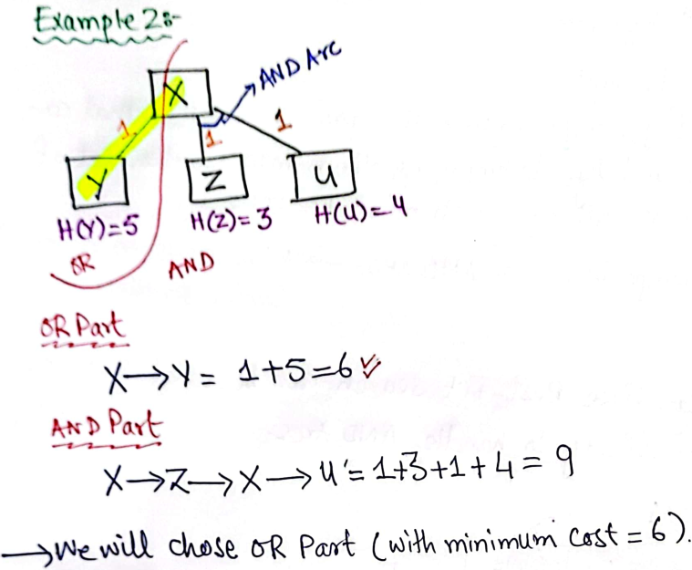
AO Star (AO*) – Example 0

Slide 42
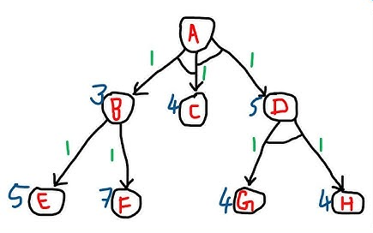
AO Star (AO*) – Example 1

Slide 43
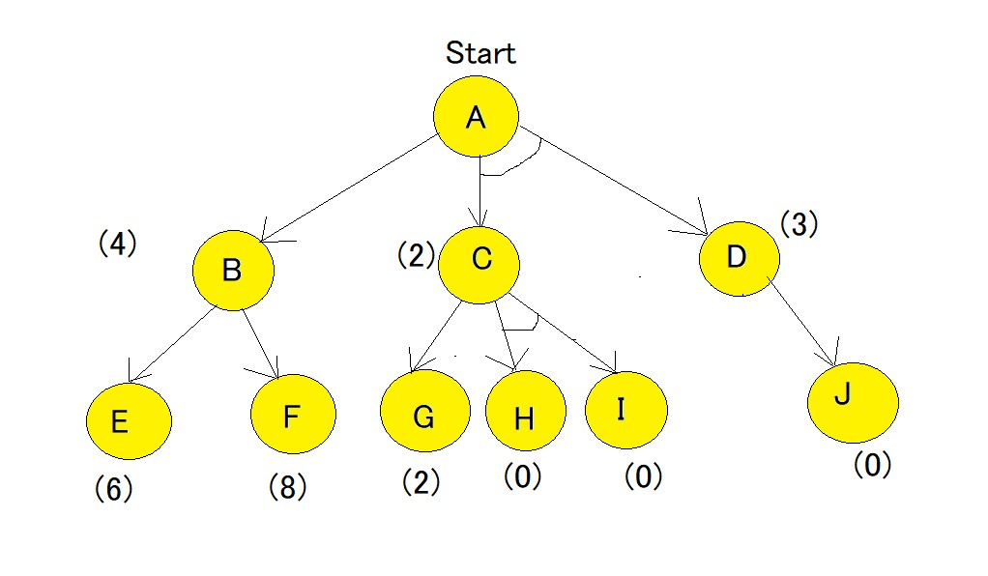
AO Star (AO*) – Example 2

Slide 44

Not included in Syllabus
If you were taking a nap, wake up… the lecture is over!

Slide 45

Recap
Informed Search Algorithms - I:
Heuristic Function and its role
Best First Search (BFS)
Beam Search - Optimized Best First Search
A Star(A*) Search Algorithm
AO Star (AO-) Search Algorithm

